Slide 1
US Consumer eCommerce Shopify Implementation
Order Management
Mar 14th, 2023

Slide 2
Points Covered
1
Creating Replacement Order
2
Changing Shipping Address on Replacement Orders
3
Filtering Replaced Orders
4
DOs and DON’Ts For Replacement
5
Order Cancellation Process
6
Order Refund Process
7
Replacement for Subscription orders with 100% Discount

Slide 3
1. Creating Replacement
Steps to Create Replacement Order
Overview
Check existing order
Create New Replacement- 1, 2, 3, 4, 5, 6, 7, 8 and 9
Verify Order- 1 and 2

Slide 4
1.a) Steps for Replacement Order
Check the existing Order
Create new Replacement Order
Verify the Order
Users should be logged in with Edit privileges on the Orders Tab.
Click on “Orders” from admin menu of left hand bar.
Locate the order to be replaced and confirm the status as “Paid” and “Fulfilled”.
Click on the order number. Ex. #1029
5. Once the order page opens, check the status “Paid” and “Fulfilled” again.
6. Click on "More Actions" dropdown.
7. Click on “Duplicate” from the drop down.
8. A Draft Order is created. Ex. D34
9. Check product name and quantity to be replaced.
10. Delete product that are not to be replaced
11. After cancelling product that are not to be replaced
12. Total price is only for product that are to be replaced
13. Add note as “#1029”
14. Add comment if necessary
15. Add “Replacement” tag here
16. Check Note
17. Check Comment
18. Check Tag
19. Click on “Collect payment”
20. Click on “Mark as paid”
21. Finally, click on “Create order”
22. New order ID is created, status “Paid”
23. Notes will show original order ID
24. Order created
To make sure this new replacement order has been communicated to the Fulfillment Center (KH), please follow the steps below
25. Go to order that was replaced.
26. Scroll extreme down to locate “Tags”. In the Tags section, if you can see “Exported” then the order is successfully exported.
27. Go to orders, scroll Right to Tags column.
28. If you can see “Exported” then the order is successfully exported.

Slide 5
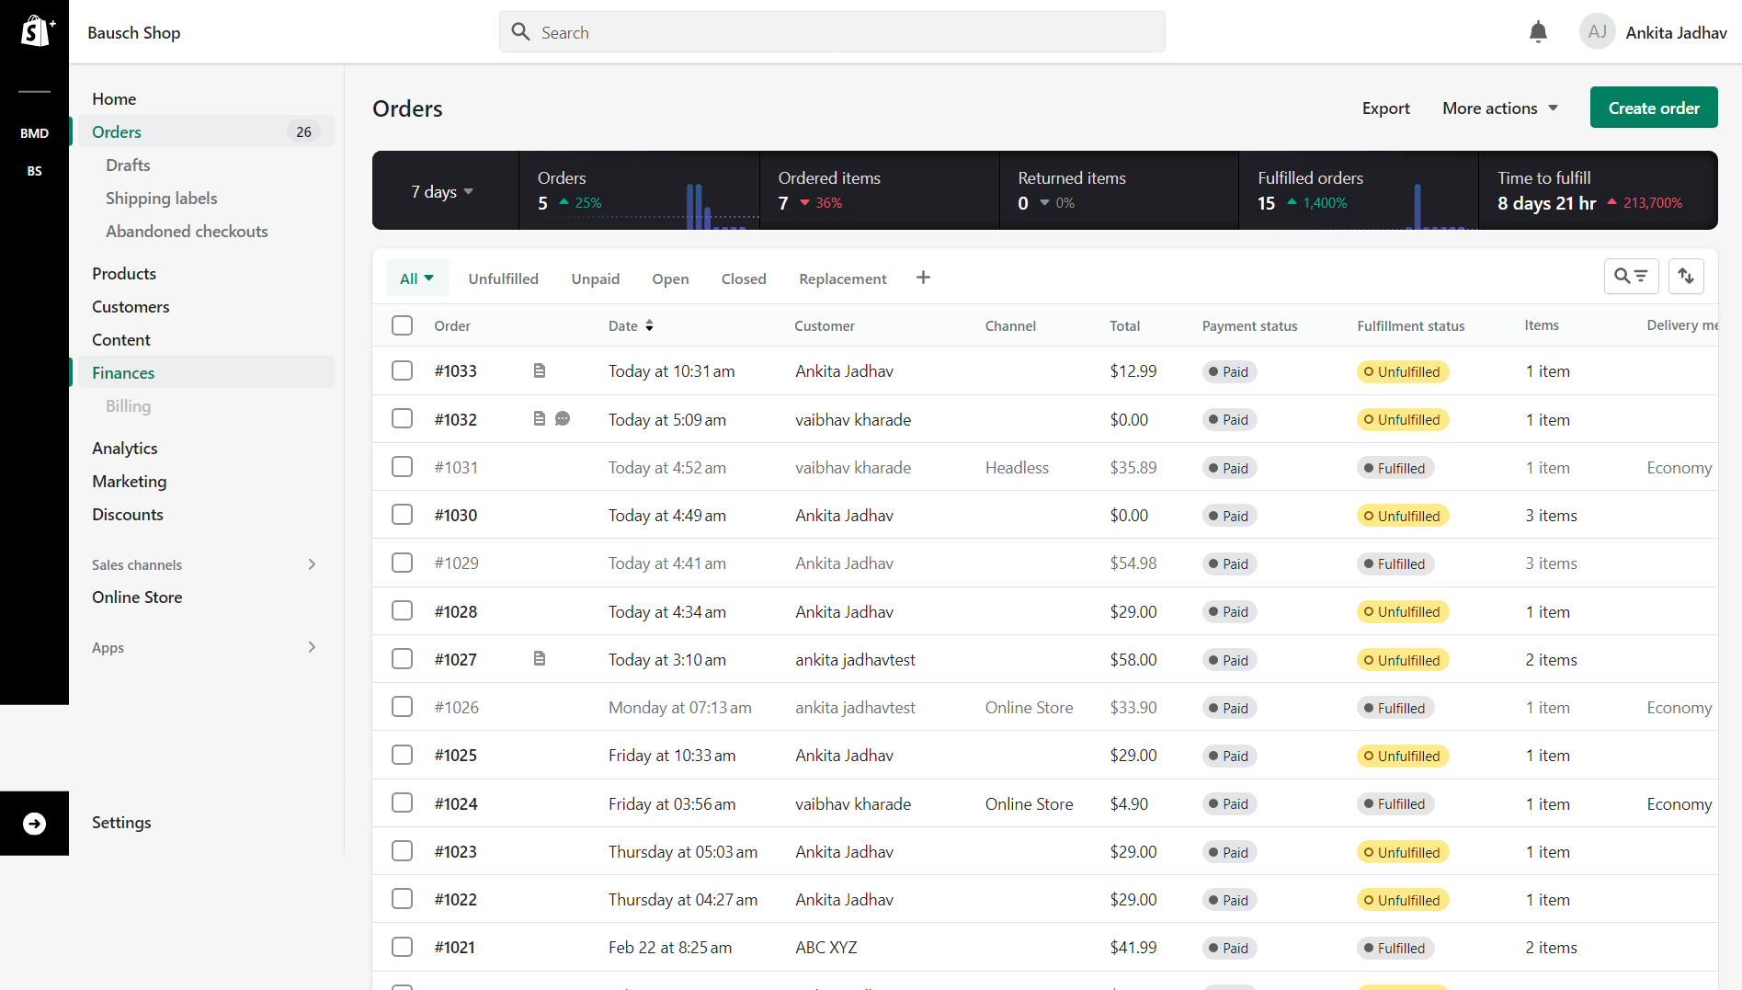
1.b.A.) Check the existing Order
1. Check login Here
2. Click “Orders”
4. Click on order number- #1029
3. Confirm order is paid and fulfilled before proceeding

Slide 6
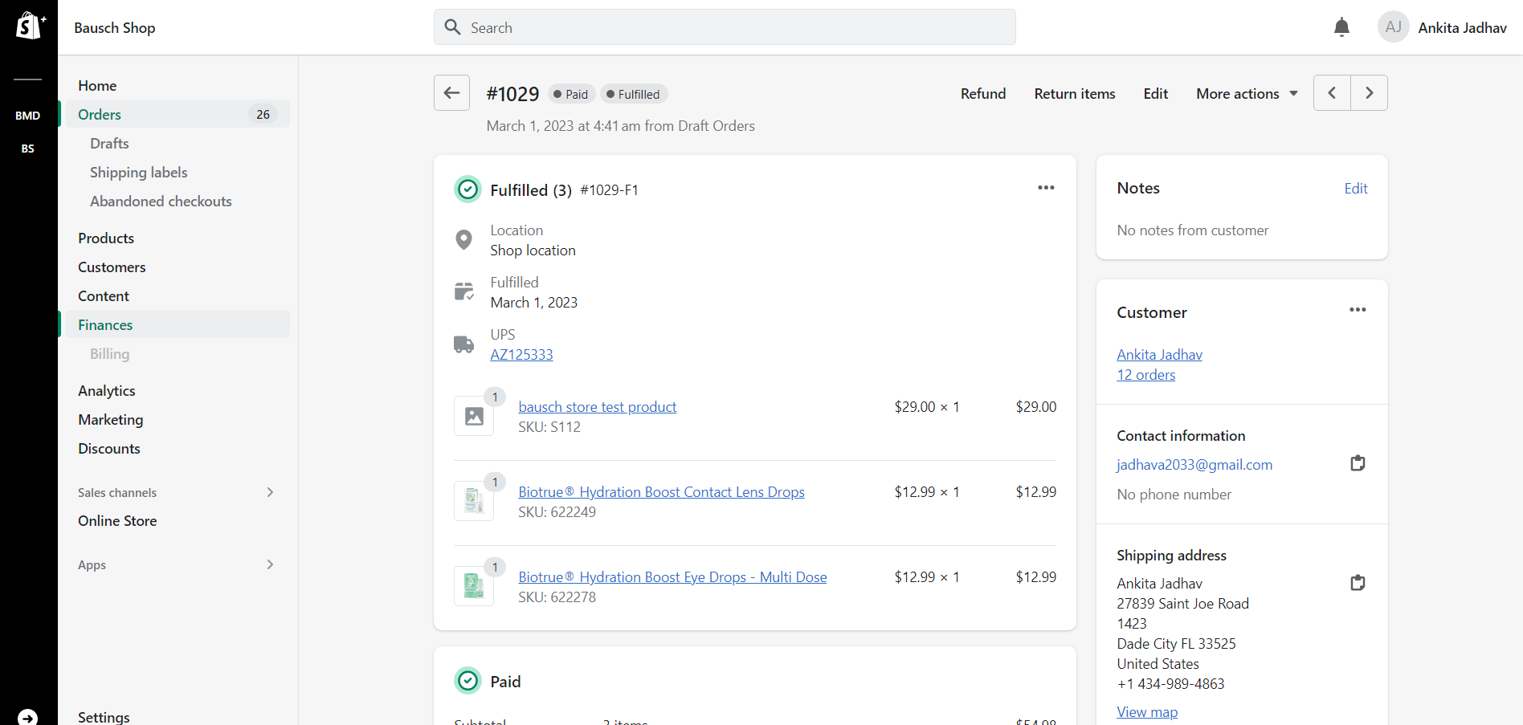
1.b.B.) Create new Replacement Order - 1
5. Check order number, paid and Fulfilled
6. Click on “More actions”

Slide 7
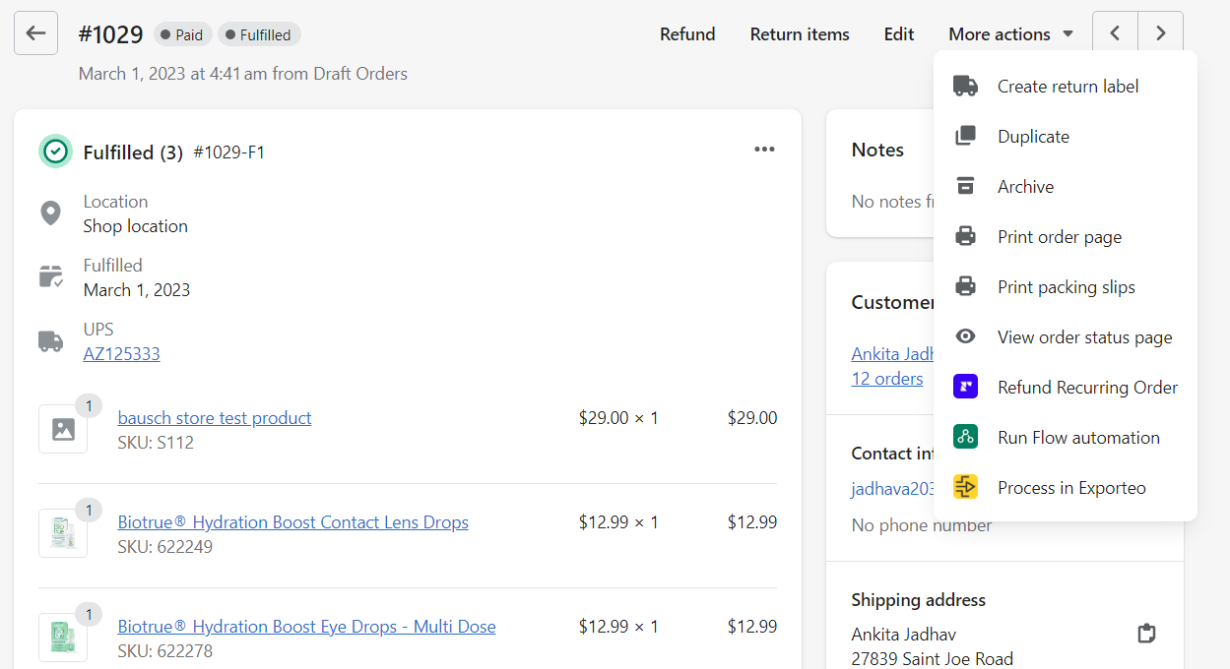
1.b.B.) Create new Replacement Order - 2
7. Click on “Duplicate”

Slide 8
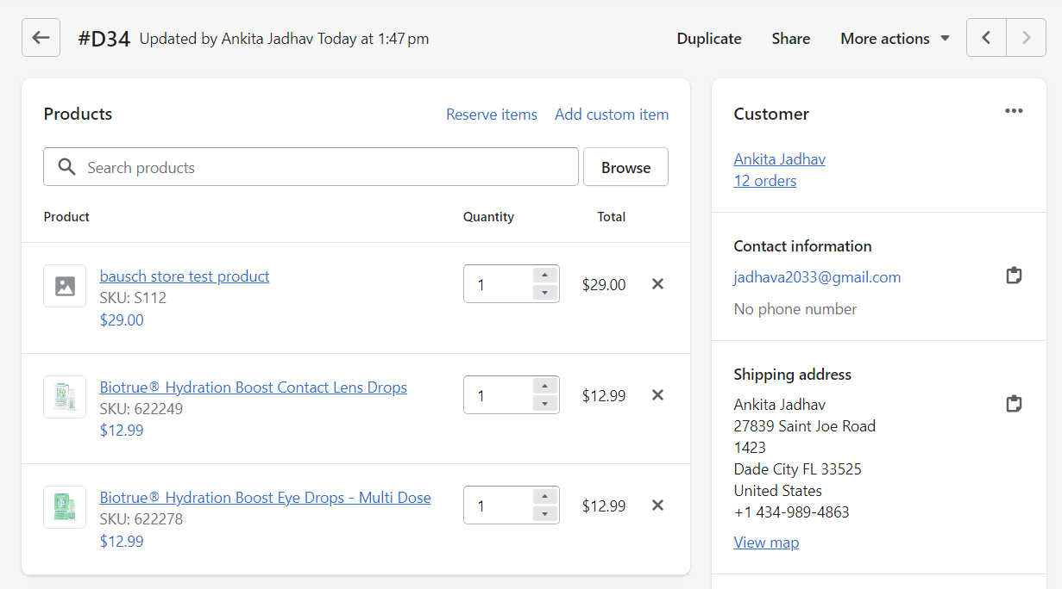
1.b.B.) Create new Replacement Order - 3
8. Check for Draft ID
10. Delete product that are not to be replaced
9. Check product name and quantity to be replaced

Slide 9
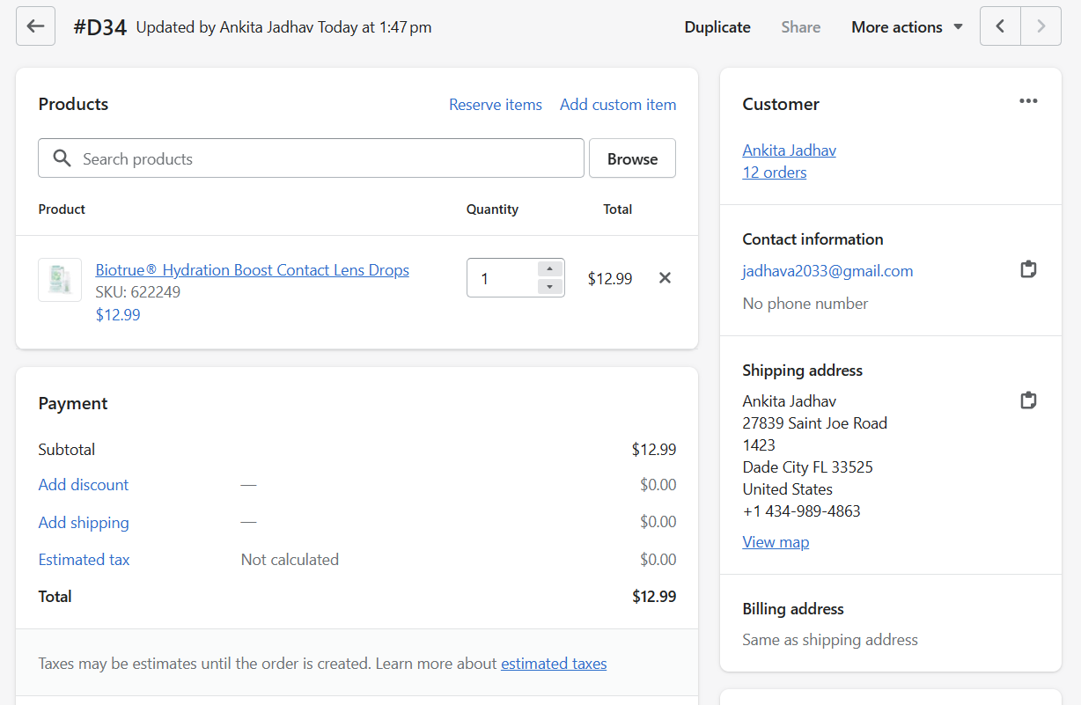
1.b.B.) Create new Replacement Order - 4
11. After cancelling product that are not to be replaced
12. Total price is only for product that are to be replaced

Slide 10
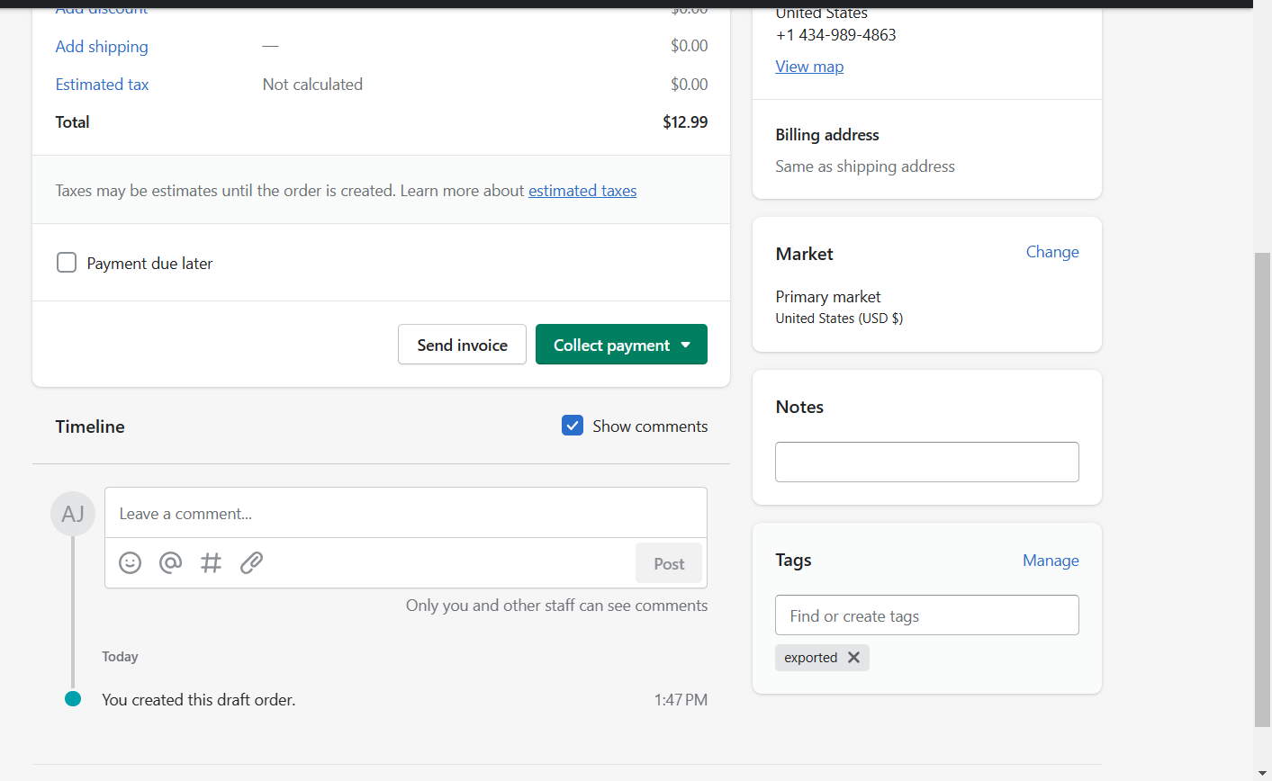
1.b.B.) Create new Replacement Order - 5
13. Add note as “#1029”
14. Add comment if necessary
15. Add “Replacement” tag here

Slide 11
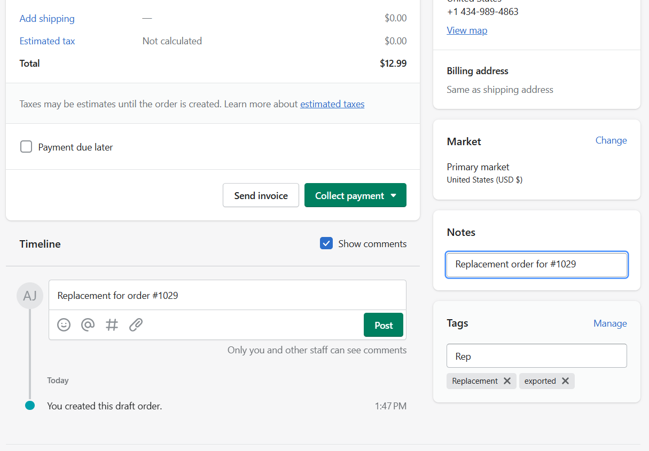
1.b.B.) Create new Replacement Order - 6
17. Comment
16. Note
18. Tag

Slide 12
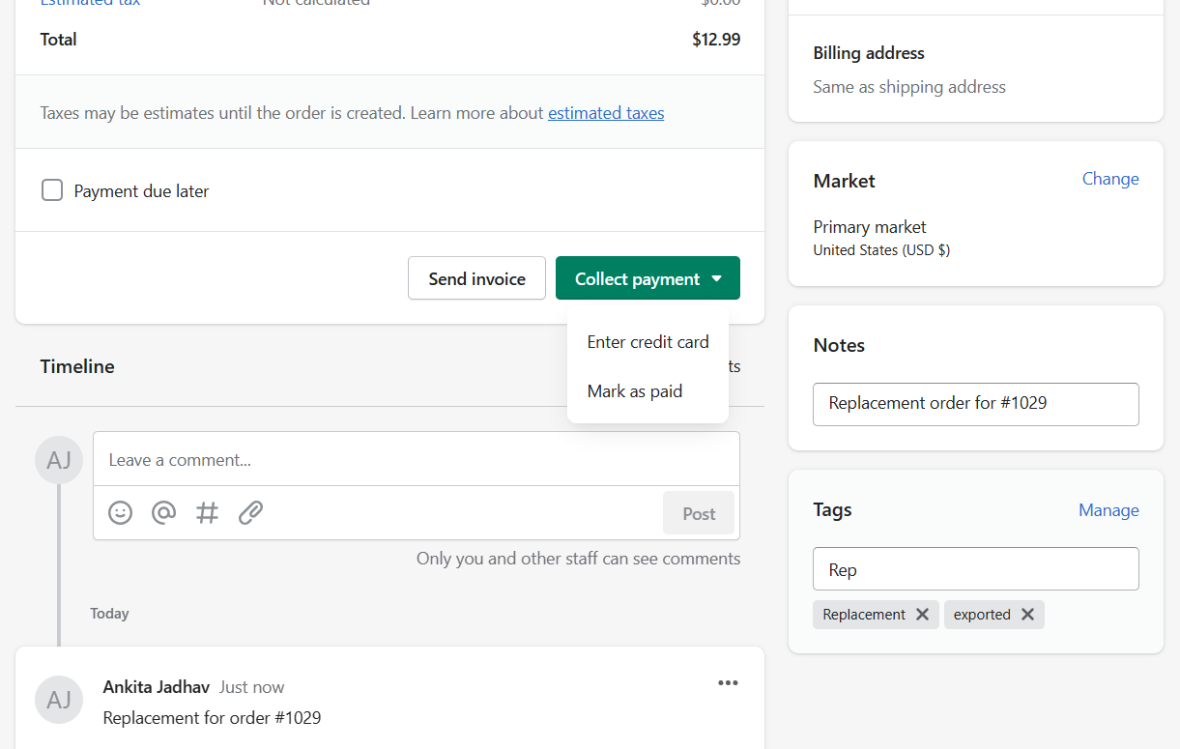
1.b.B.) Create new Replacement Order - 7
19. Click on “Collect payment”
20. Click on “Mark as paid”

Slide 13
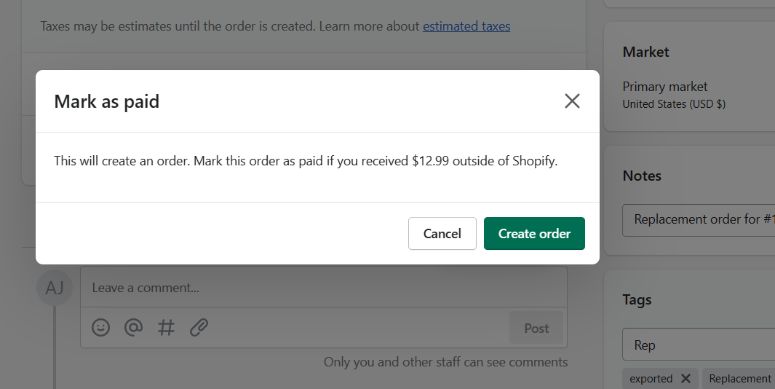
1.b.B.) Create new Replacement Order - 8
21. Finally, click on “Create order”

Slide 14
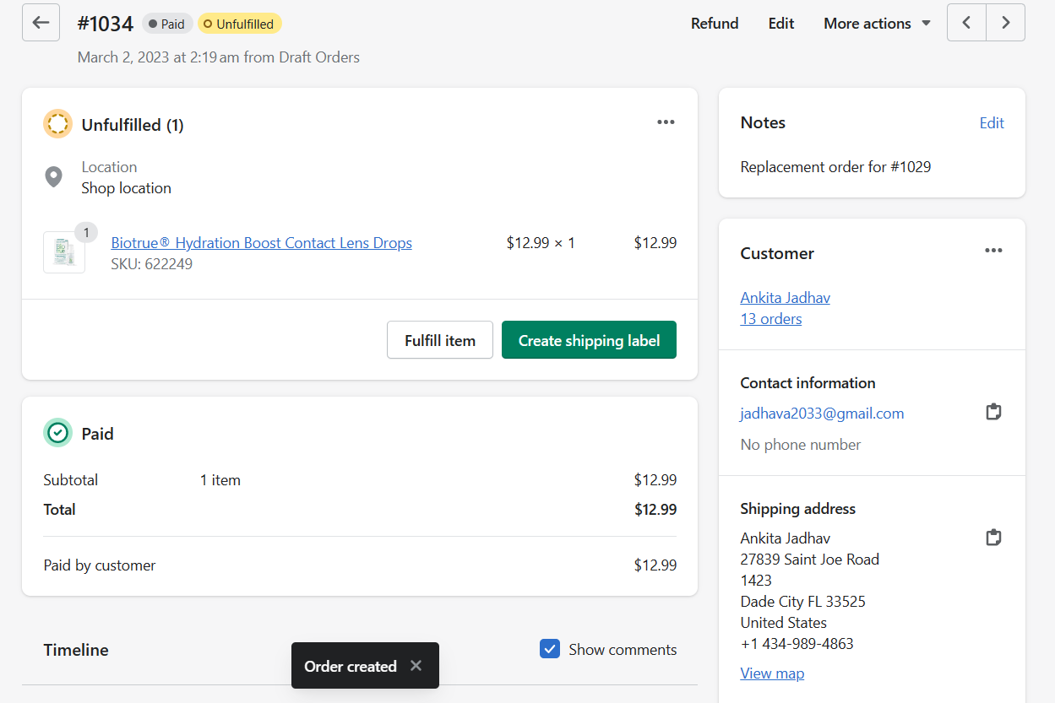
1.b.B.) Create new Replacement Order - 9
22. New order ID is created, status “Paid”
23. Notes will show original order ID
24. Order created

Slide 15
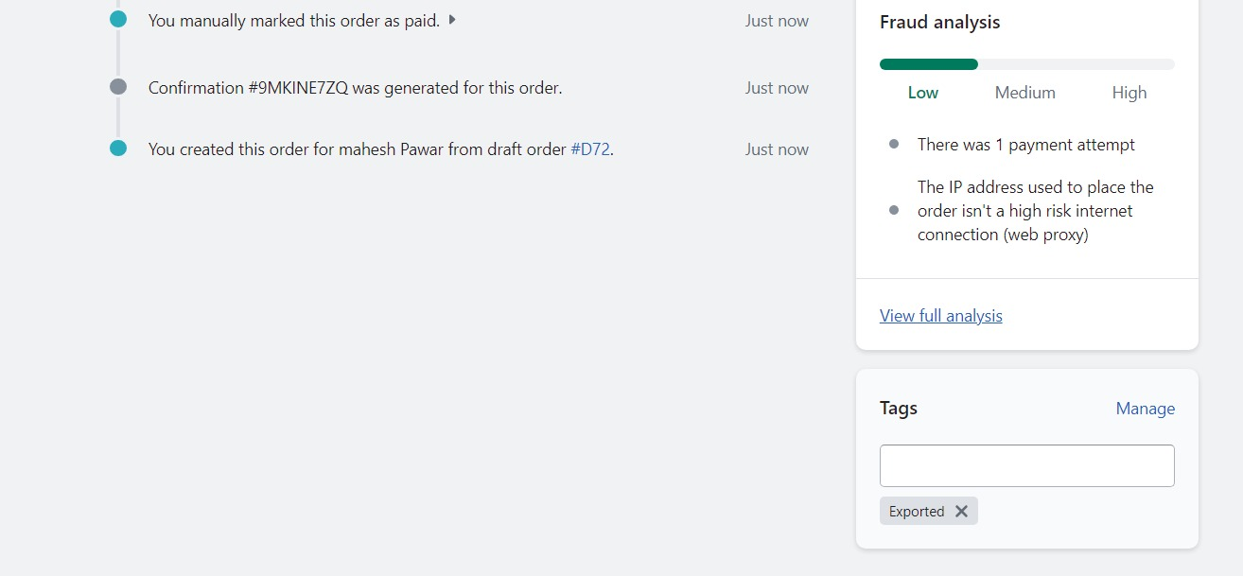
1.b.C.) Verify The Order - 1
26. Check the tag – “Exported”
If tag appears, the order is exported to Knipper successfully.
25. Click on “Order #1034” After few minutes.

Slide 16
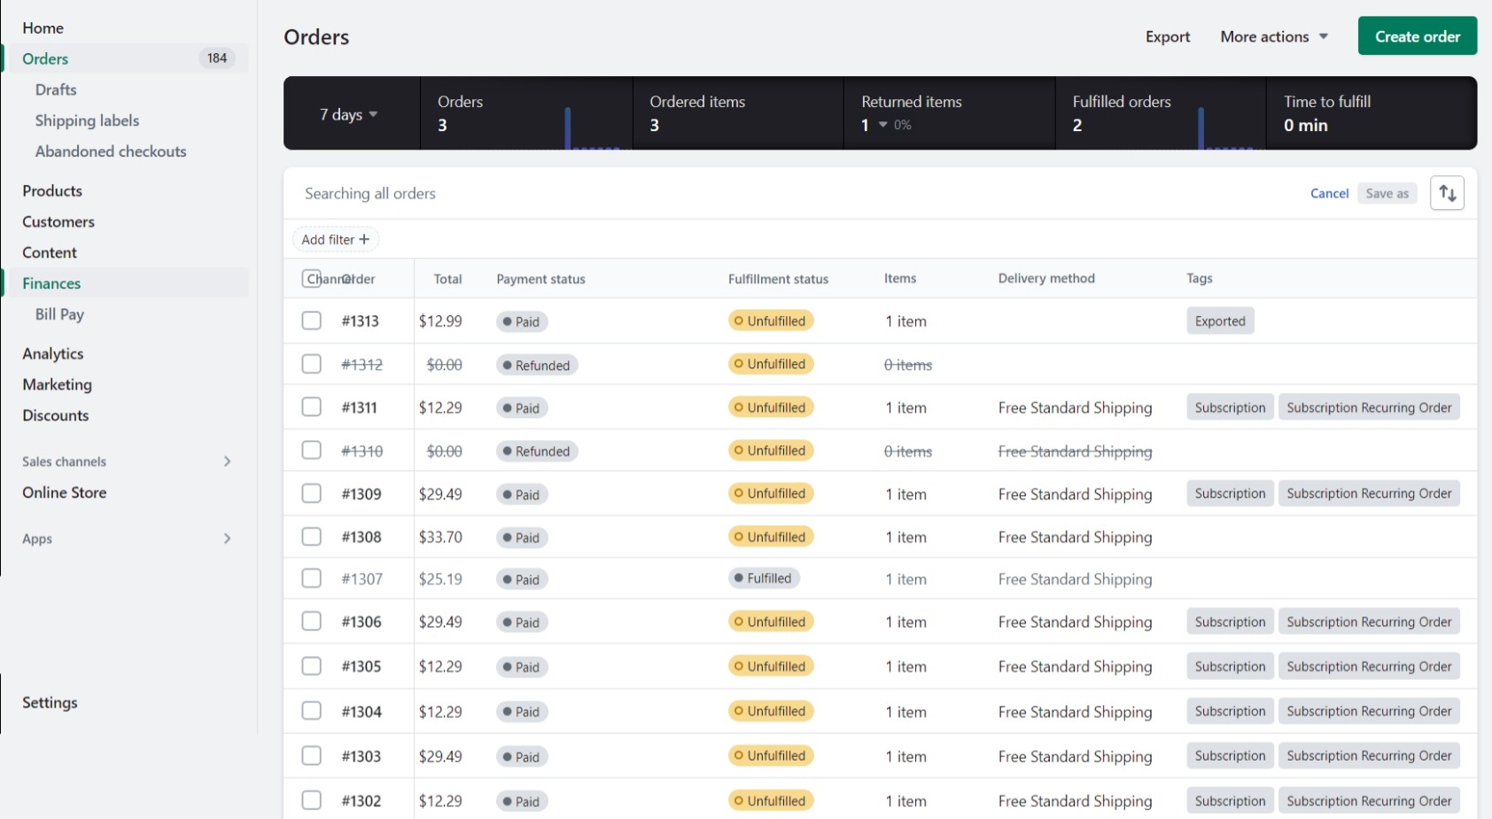
1.b.C.) Verify The Order - 2
27. Click on “Orders”
28. Scroll to “Tags” column and check the locate tag – “Exported”

Slide 17
2. Changing Shipping Address on Replacement Order
Questionnaire
Steps to change Shipping address
Change Shipping address- 1, 2, 3, 4 and 5

Slide 18
2.a.) Questionnaire
When to change shipping address?
Customer moved
Selected incorrect address while placing order
Address undeliverable after multiple attempts and similar situations
When can CSA change address?
If the address is added to customer's address book.
What if address isn't added to customer's address book?
Guide customer to add address first and then change in replacement.
Are notes mandatory for address change?
Any change made on replacement order should be added to notes for future reference.
All the acceptable changes can be arranged in standard note
ex. Original order: #1029
Address changed: Yes/No
Replaced: Once/Twice/Thrice
Reason: Damaged/Lost/Expired
Replacing after: 1 week/ 1 month/ 2 days, etc
How to add address?
Login to your account.
Go to "Manage Addresses“
Click on "Add Address“
Add the address and click on "Save"

Slide 19
2.b.) Steps to change Shipping Address
Complete steps 1 to 18 as in replacement slides shown in Replacement Order 3.0.
18.1 Now click on “…” button in front of “Customer”.
18.2 Click on “Edit Shipping Address”
18.3 Click on “Select Address”
18.4 Select the preferred address.
18.5 Click on “Done”
Continue with steps after no. 18 as it is from Replacement Order 3.0

Slide 20
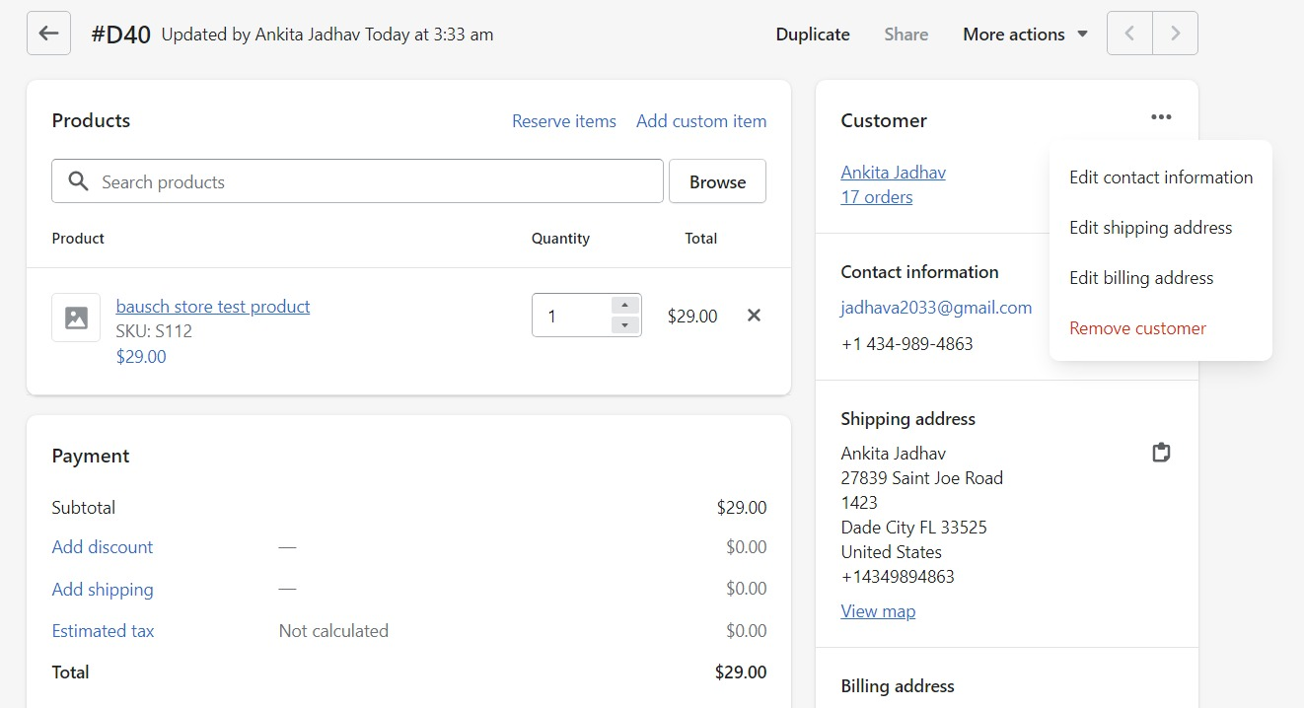
2.c.) Change Shipping Address - 1
18.1 Click on “…” for options as shown.
18.2 Click on “Edit shipping address”
Original Shipping address

Slide 21
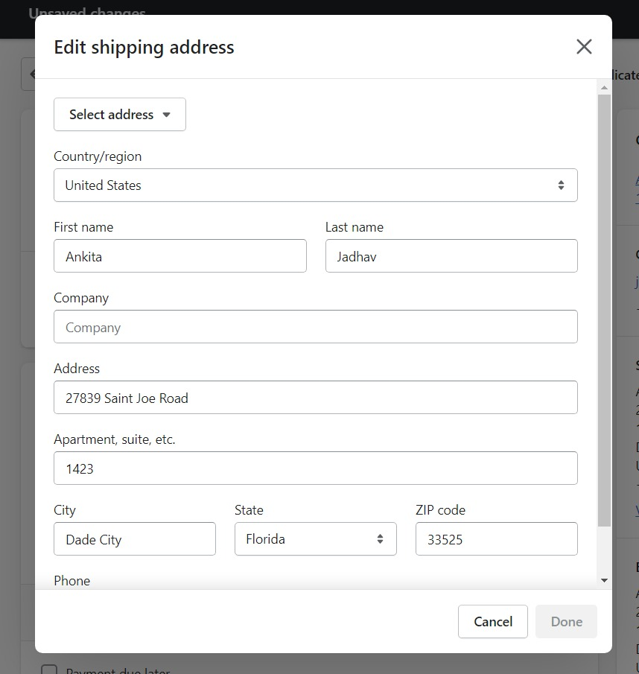
2.c.) Change Shipping Address - 2
18.3 The pop-up appears.
Click on “Select address”

Slide 22
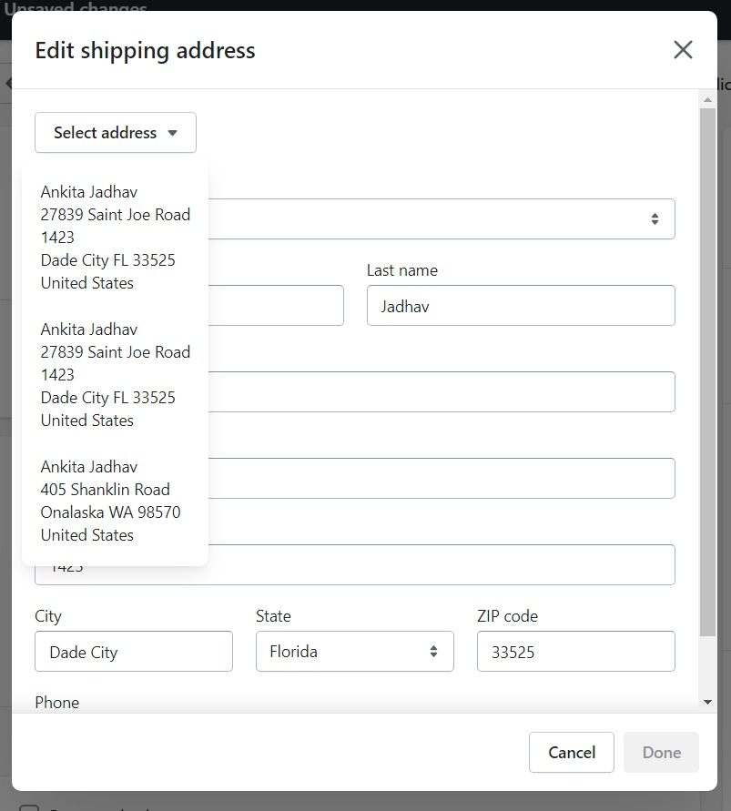
2.c.) Change Shipping Address - 3
18.4 List of addresses appears. Click on address customer wants

Slide 23
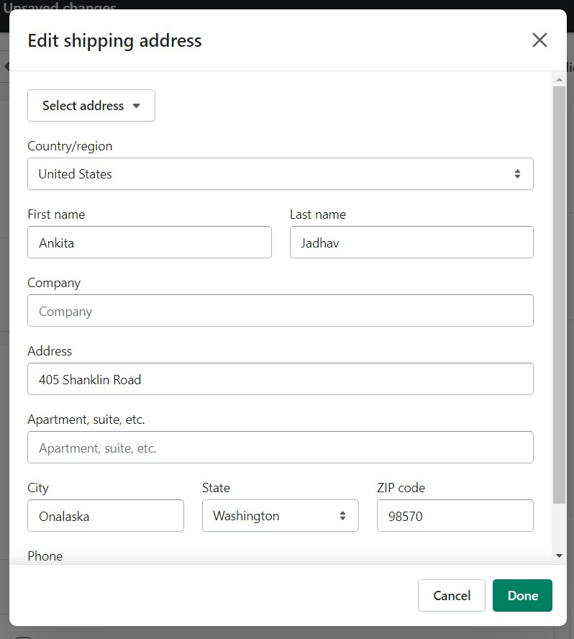
2.c.) Change Shipping Address - 4
18.5 Click on “Done”

Slide 24
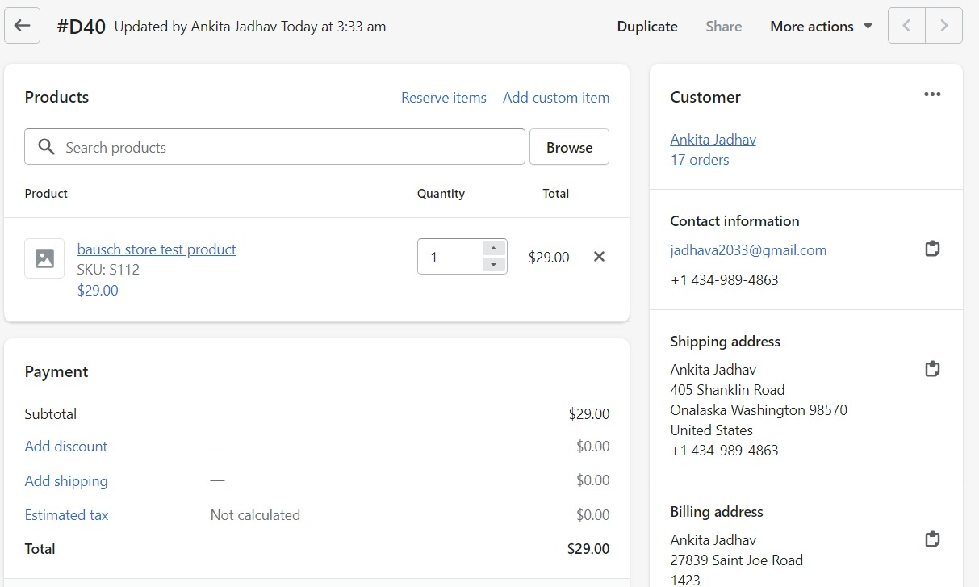
2.c.) Change Shipping Address - 5
Updated Shipping address
Continue from step 19 from Replacement order 3.0

Slide 25
3. Filtering Replaced Orders
Steps to Filter Replaced orders
Overview

Slide 26
3.a.) Steps to Filter Replaced Orders
Click on “Orders”
Click on “Replacement”
Get all replaced orders

Slide 27
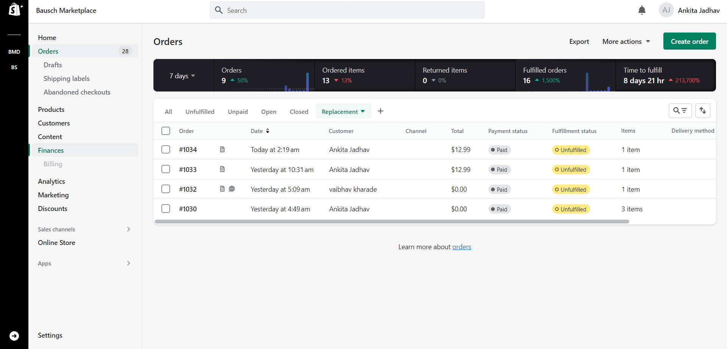
3.b.) Overview
1. Click on “Orders”
2. Click on “Replacement” to view all the replacement orders
3. Replaced order #1034

Slide 28
4. DOs and DON’Ts for Replacement orders
DOs
DON’Ts
Keep In Mind

Slide 29
4. DOs and DON’Ts For Replacement
Dos-
DON’Ts-
Check for correct order number to be replaced
Check if original order is paid and fulfilled
Check for product name and quantity to be replaced
And required tags and notes
Add replacement tags to original order
Increase product quantity
Add product which in not in original order
Add discount that is not in original order
Change shipping or billing address
Edit any customer information unless authorized
Keep In Mind
Only one order number can be replaced at a time
No option to replace multiple orders at a time, in bulk

Slide 30
5. Order Cancellation Process
Order Cancel Rules
Steps to cancel order
Overview- 1, 2, 3 and 4

Slide 31
5.a.) Order Cancellation Rules
Order should not be fulfilled
Order must be paid
Once cancelled, same order can’t be shipped.
If order is cancelled mistakenly, customer has to create new order
If customer’s card is authorized, the card will reflect amount within 3-5 business days
If order is already fulfilled, customer can refuse the order for refund.
If customer wants to cancel few items and not all order, we need to edit the order instead of cancelling
We need to educate customer that by cancelling order all the items from the order will be cancelled

Slide 32
5.b.) Steps to Cancel Order
Click on “Orders”
Select Order that is to be cancelled. e.g. #1013
Click on “More actions”
Click on “Cancel order”
Select Reason
Click on “Cancel”

Slide 33
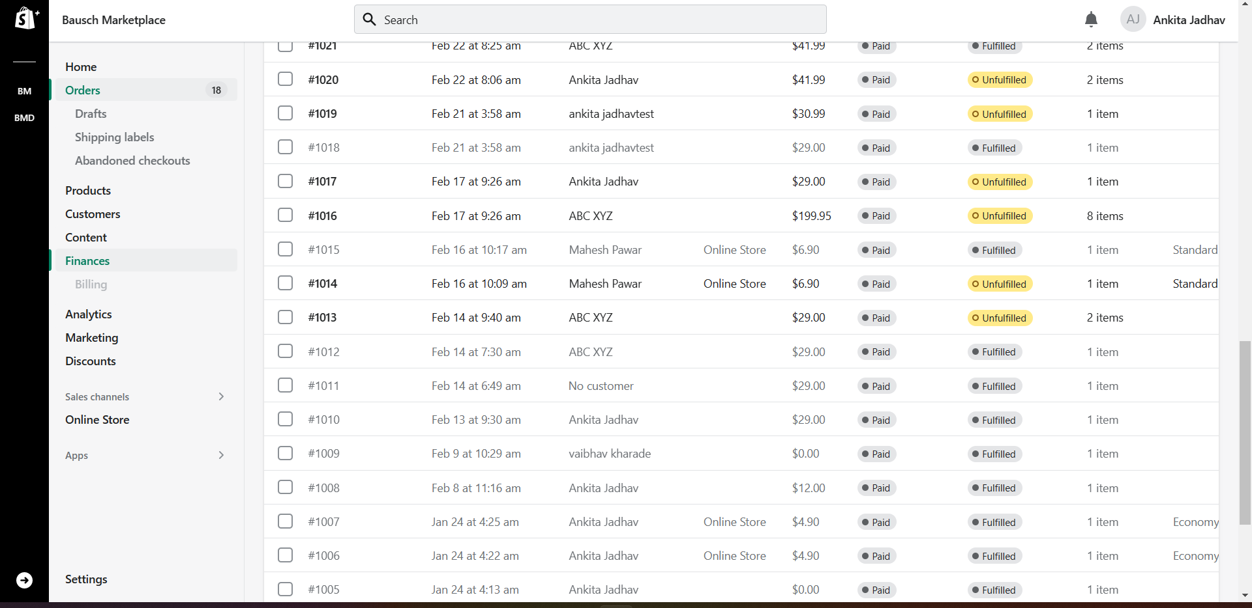
5.c.) Overview- 1
Click on “Orders”
Click on Order to be cancelled

Slide 34
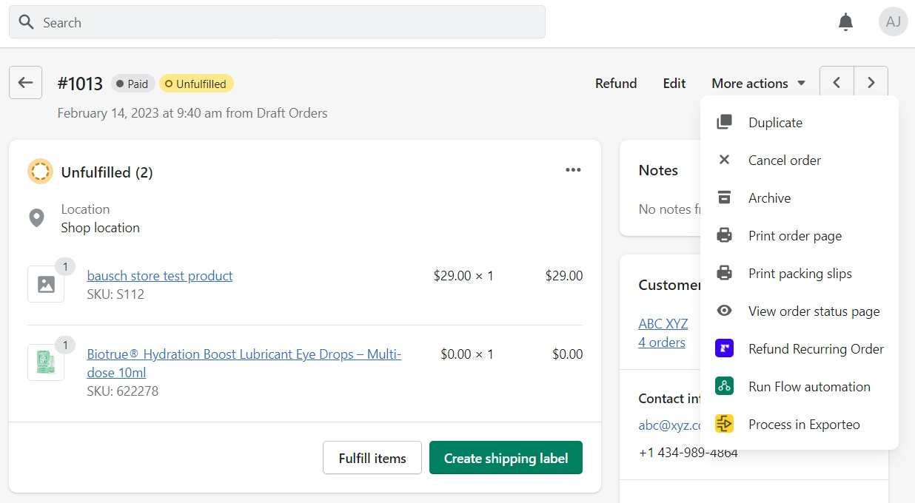
5.c.) Overview- 2
Click on “More actions”
Click on ”Cancel Order”

Slide 35
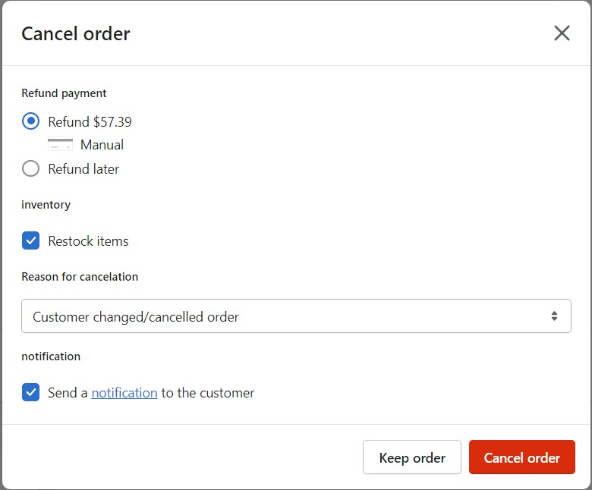
5.c.) Overview- 3
Click here to change “Reason for cancelation”
Click on ”Cancel Order”

Slide 36
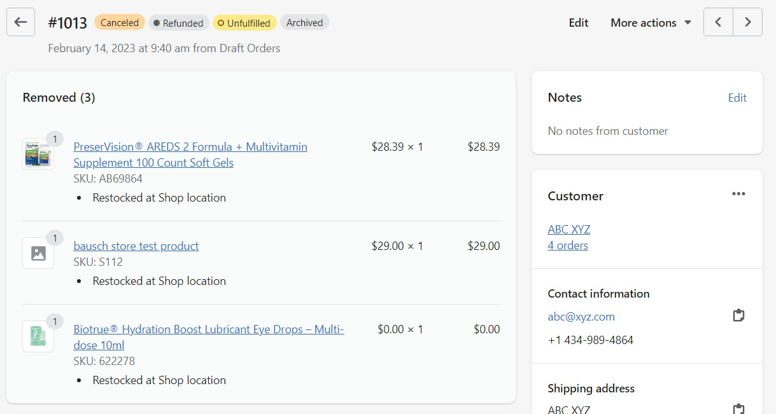
5.c.) Overview- 4
Status changed to “Canceled”

Slide 37
6.Order Refund process
Refund Rules
Steps to Refund order
Overview

Slide 38
6.a.) Refund Rules
Type of refund
Itemized refund
Manual/Partial
Complete
Refund can be issued only on paid orders
Refund can be issued on either fulfilled or unfulfilled orders
Refund amount can’t be more than order total
“Reason for Refund” must be entered manually
Refund can’t issued to different payment method
In case of special scenario, we need to ask customer to contact card issuing bank with refund details in case of card expired/lost, etc.

Slide 39
6.b.) Steps to Refund Orders
Click on “Orders”
Click on order that is to be refunded.
E.g. 1037
Click on “Refund”
Add refund details and “Reason for refund”

Slide 40
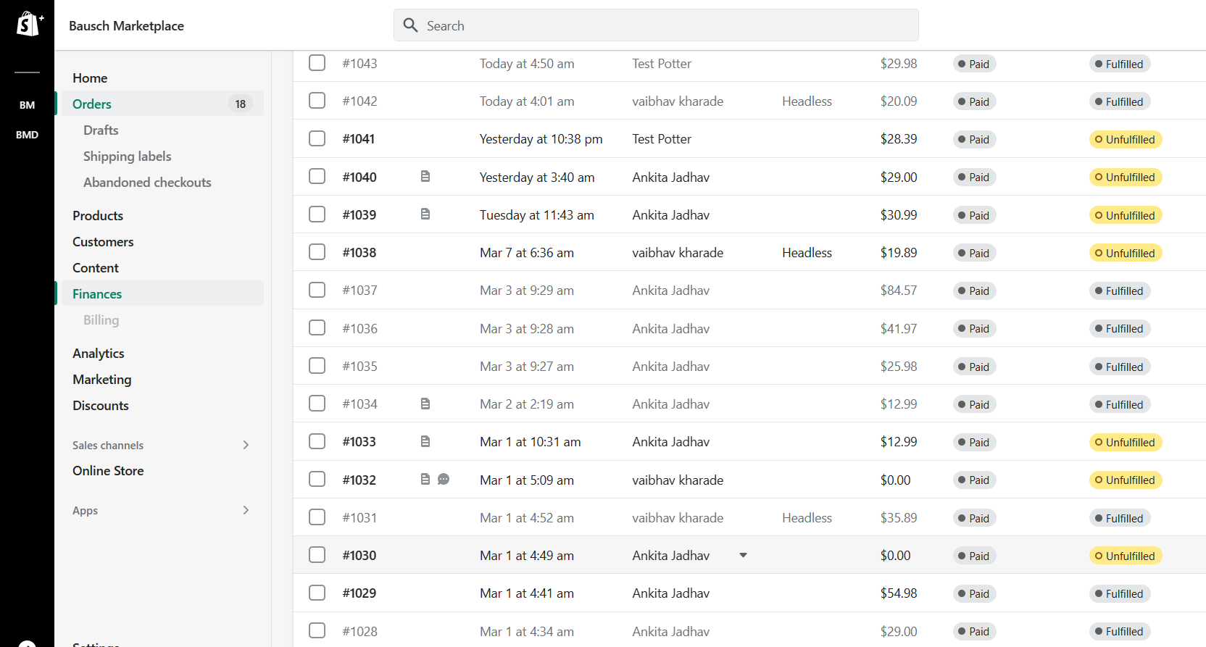
6.c.) Overview- 1
Click on “Order”
Click on Order to be refunded

Slide 41
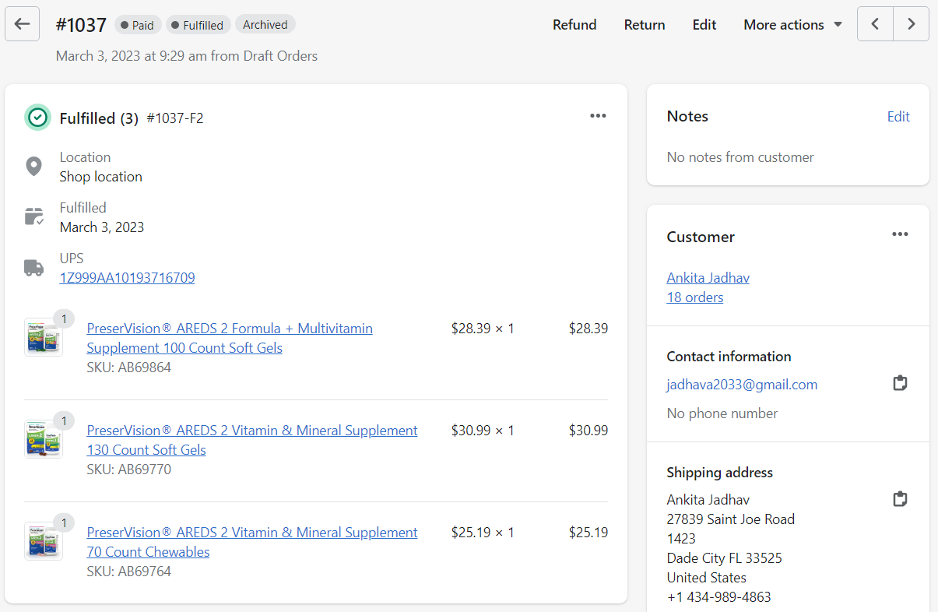
6.c.) Overview- 2
Click on “Refund”

Slide 42
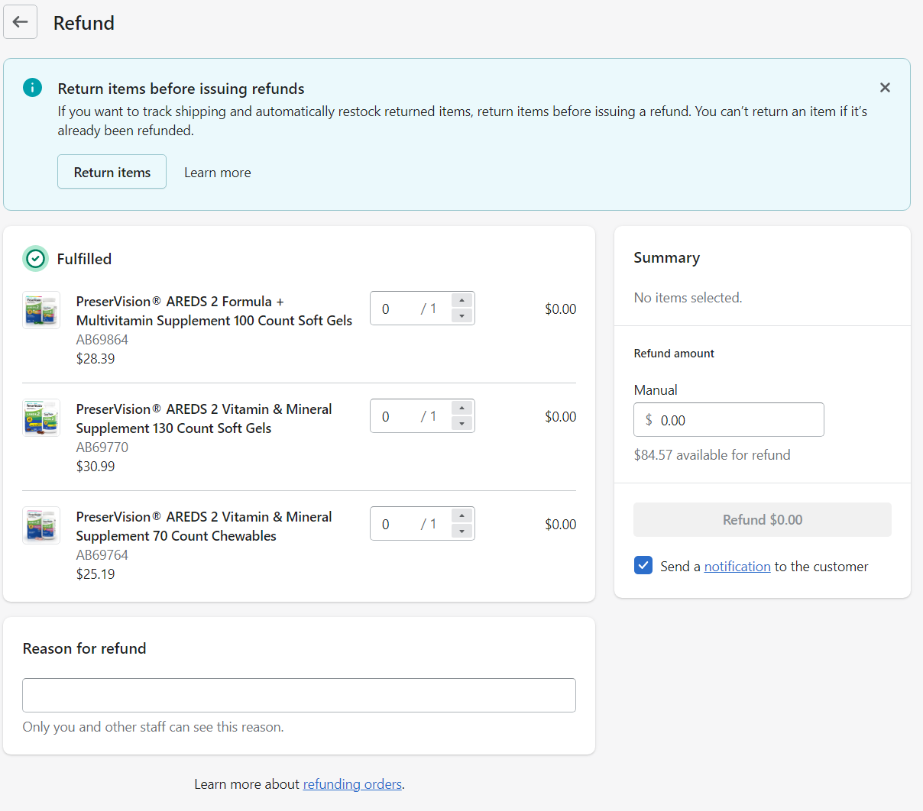
6.c.) Overview- 3
Increase quantity is refund is itemized refund.
Select all items for Complete refund.
Add amount is refund is manual/partial/tax
Enter “Reason for refund”

Slide 43
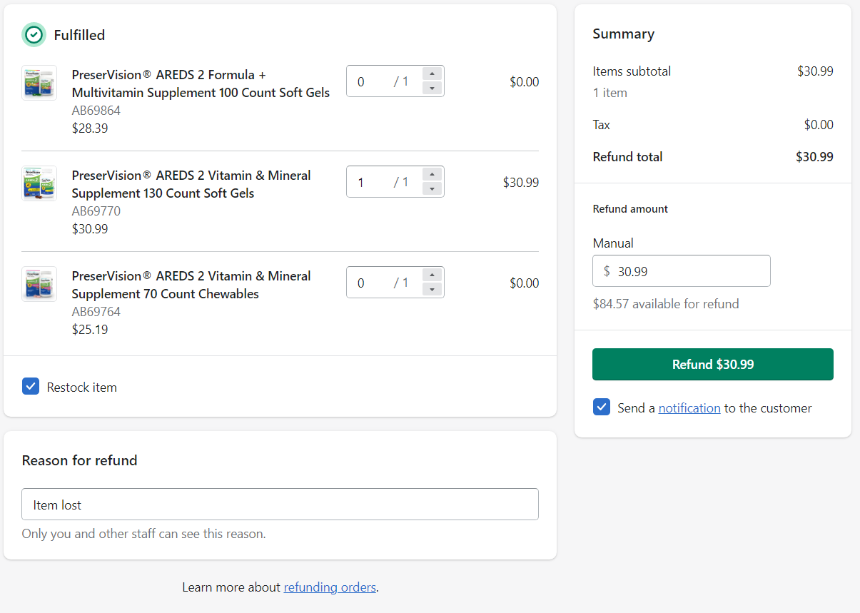
6.c.) Overview- 5
Summary of refund
Refund button is activated.
Click on “Refund $30.99”
Check/Uncheck to notify customer
“Reason for refund”

Slide 44
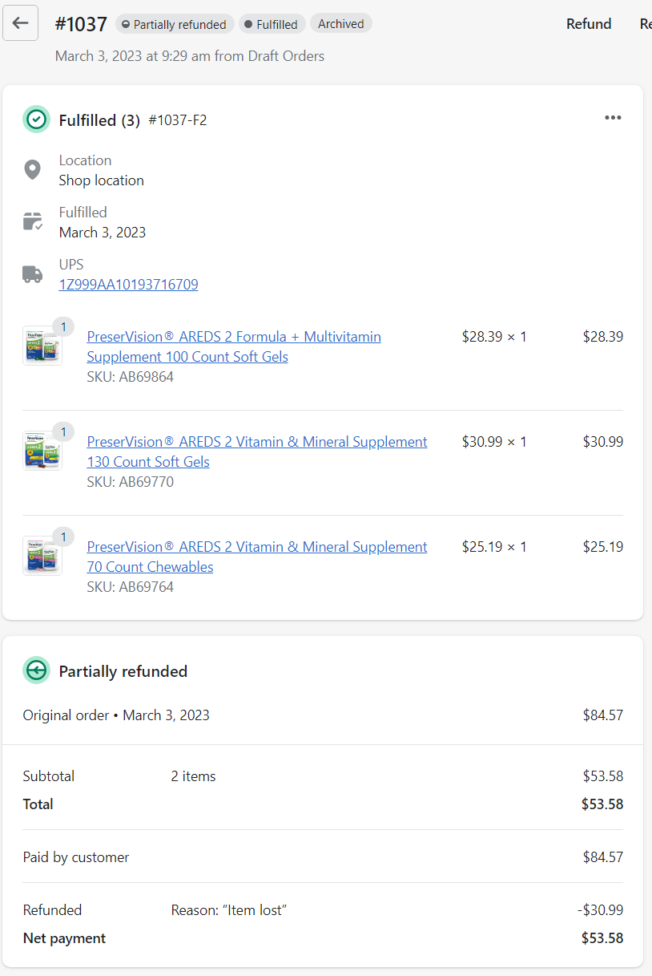
6.c.) Overview- 5
Order status after Refund
Reason of refund
Refunded amount
New order total after refund

Slide 45
7. Replacement for Subscription orders
Replacement Rules
Replacement Process

Slide 46
7.a.) Replacement Rules
Please be cautious of the rules below before you start making the replacement order with 100% Discount and then Mark it as “Paid”. Please note, these are all manual steps and there is no check that can be put in place for any error
Verify customer's name for correct spelling.
Confirm complete and accurate address manually.
Double-check customer selection, shipping address, and replacement product.
No credit card details required since we will be applying a discount of 100%
Apply discount of 100% cautiously, ensuring it does not exceed the original order price.

Slide 47
7.b.) Replacement Process
There are 15 steps in the replacement process that need to be followed in order to make a replacement order with 100% discount
Please go through the following 9 slides that lists the detailed instructions with the attached screenshots
Please follow these instructions in the sequence in which they are mentioned

Slide 48
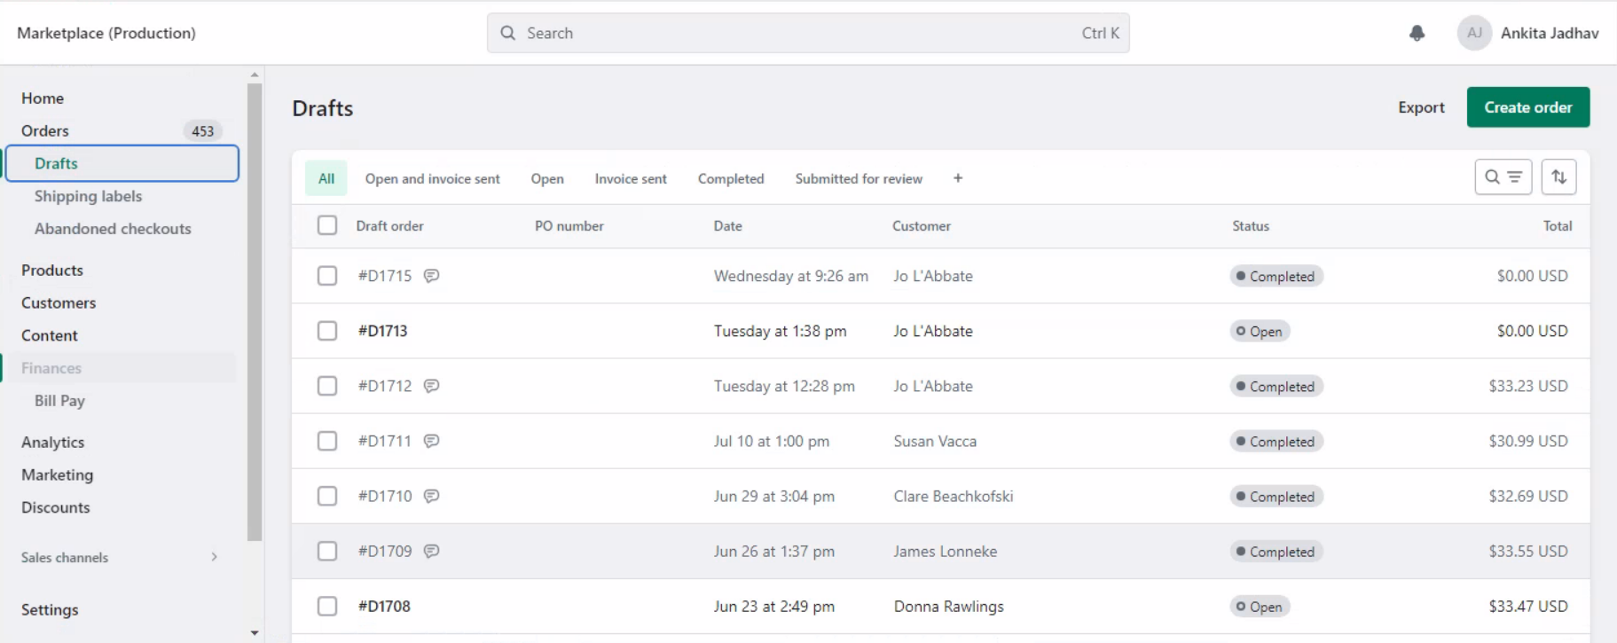
7.b.) Replacement Process - 1
2. Click on “Create Order”
1. Click on “Drafts” under “Orders”

Slide 49
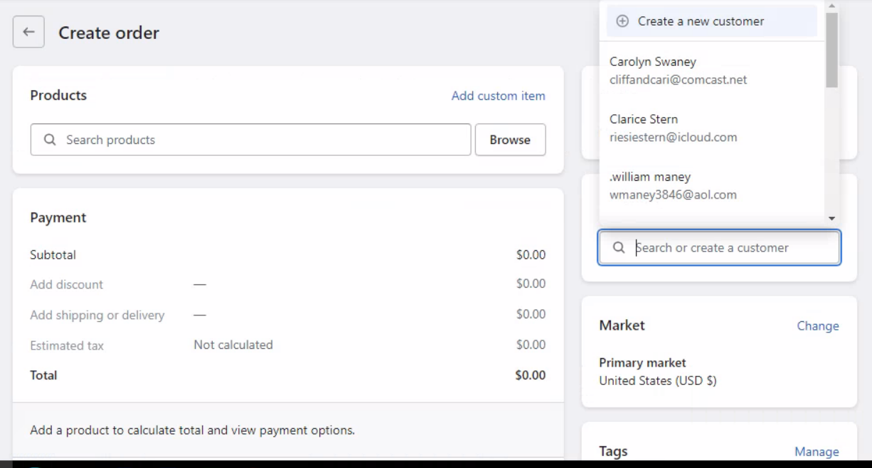
7.b.) Replacement Process - 2
3. Search for contacting Customer and select the correct customer.

Slide 50
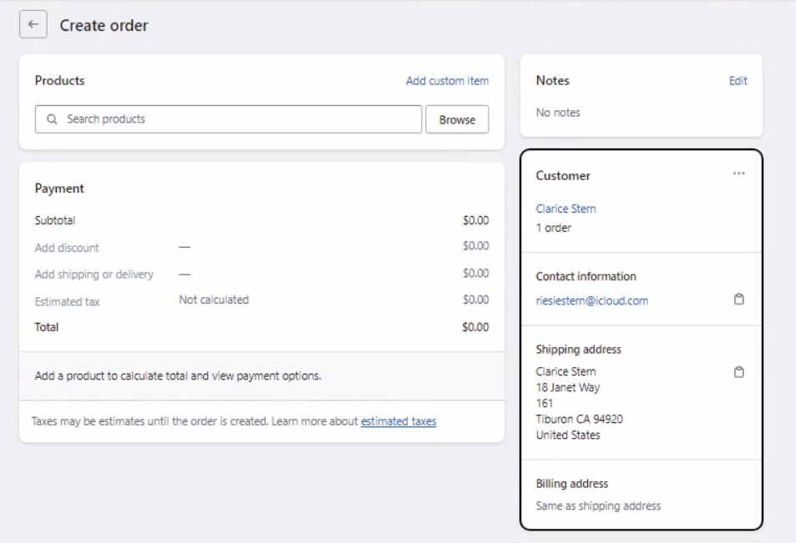
7.b.) Replacement Process - 3
5. Click on “Browse” to select product
4. Check if shipping address is correct.

Slide 51
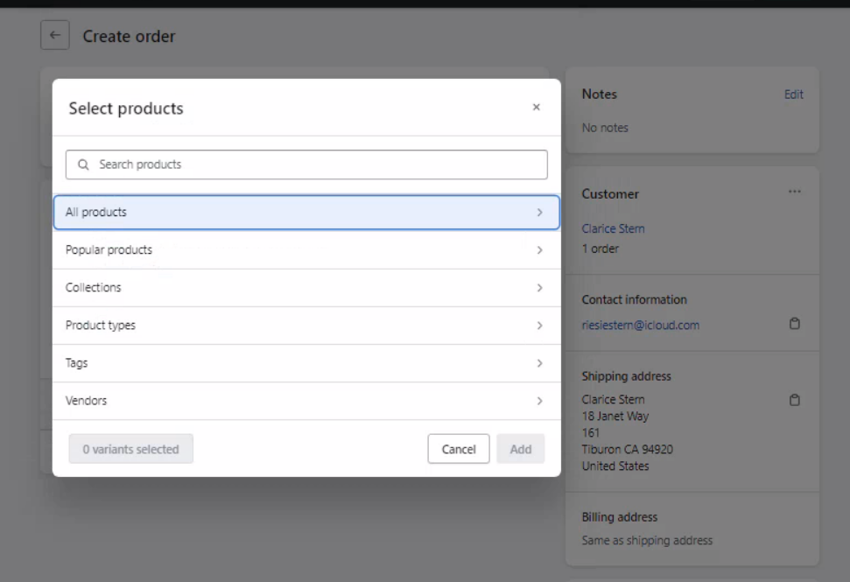
7.b.) Replacement Process - 4
6. Click on “All products” to locate the product to be replaced

Slide 52
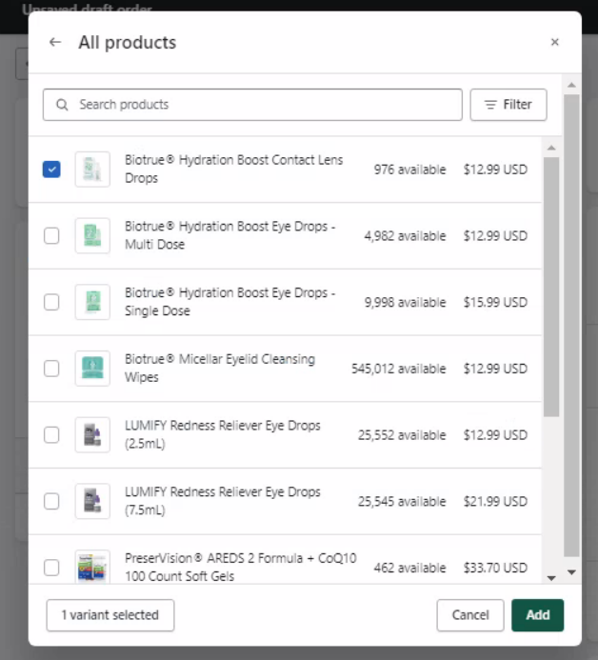
7.b.) Replacement Process - 5
7. Select the product to be replaced by checking the box
8. Click on “Add”

Slide 53
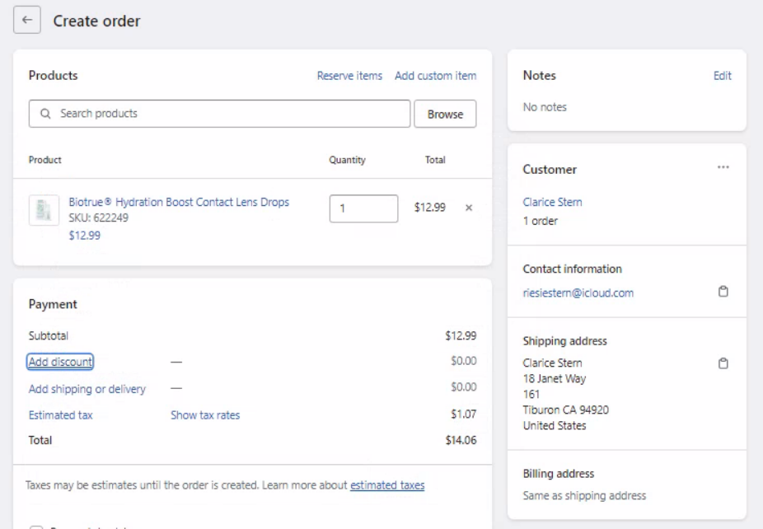
7.b.) Replacement Process - 6
9. Click on “Add discount”

Slide 54
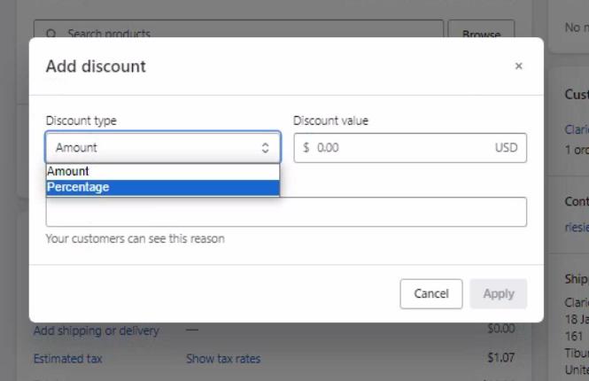
7.b.) Replacement Process - 7
10. Select Discount type as “Percentage” for replacement
Select Discount type as “Amount” in case of discount other than 100%

Slide 55
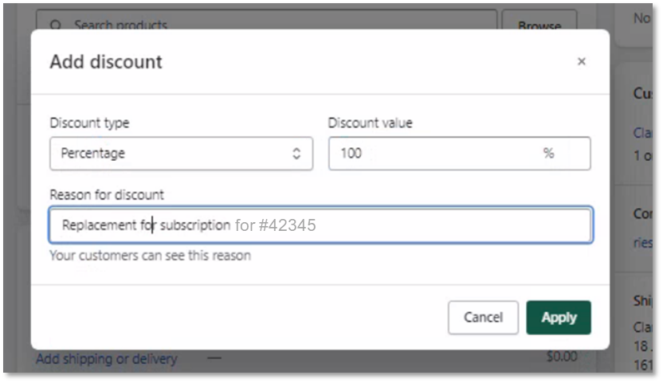
7.b.) Replacement Process - 8
11. Add “Discount value” of 100%
12. Enter “Reason for discount”
13. Click “Apply”
12a Enter the reference order number of the original subscription order

Slide 56
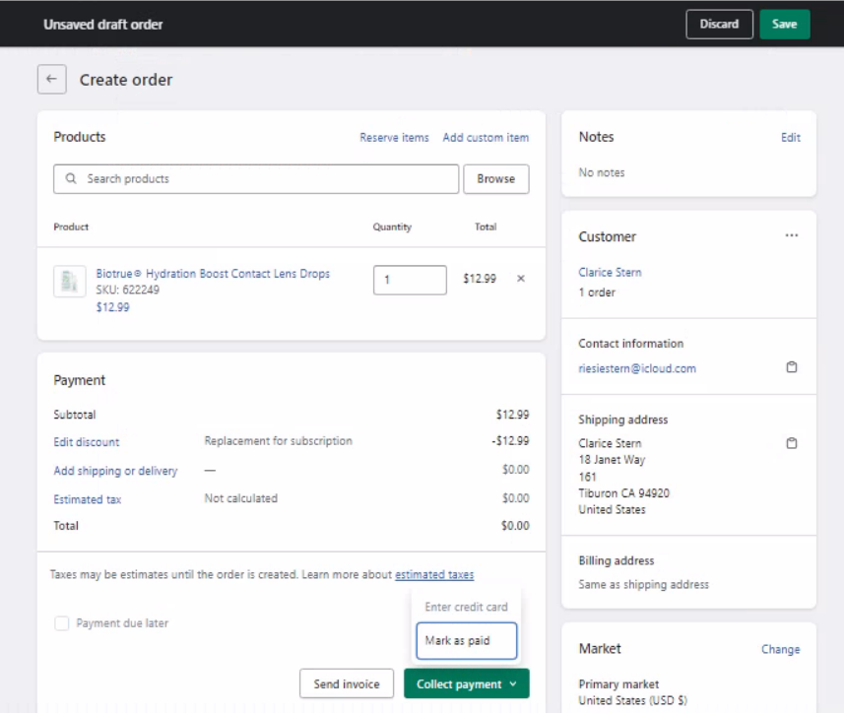
7.b.) Replacement Process - 9
15. Click on “Save
14. Click on “Collect payment” And then click on “Mark as paid”

Slide 57
Thank You

